Slide 1
Route Search System
Design & Implementation
Presentation
CSCE 2110.501 (13359)
Zion Welsh
Alan Wu
Caleb Layfield

Slide 2
Project overview and Key Designs
Purpose: Graph based flight route system
Cities = nodes, flights = edges
Supports BFS, DFS, multistop routing
Our Chosen design:
  Adjacency list graph
  Hash map city indexing
  State based parsing

Slide 3
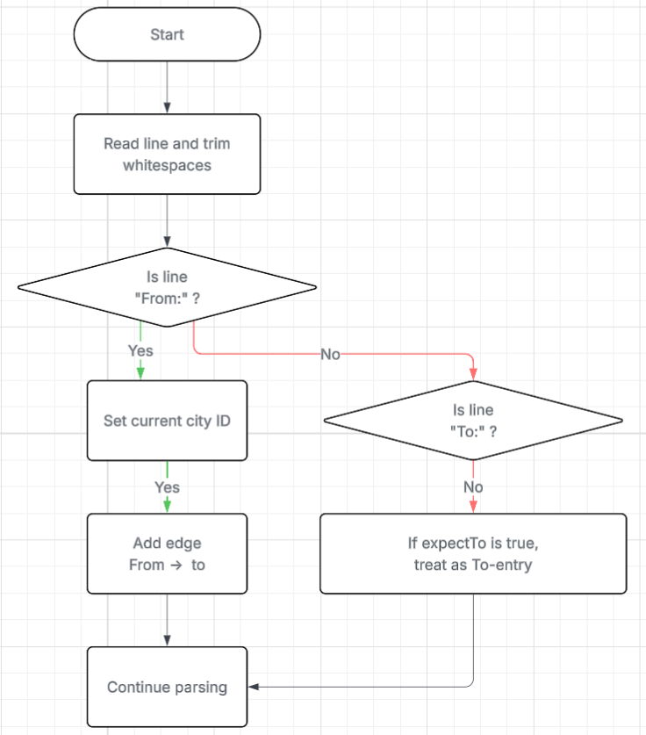
Flowchart: Input Parsing
Handles the flexible From/To format
Uses trimming + state switching
Builds graph during parsing
Flow charts were made via: lucidchart.com

Slide 4
Data Structures
01.
vector<string> names
02.
unordered_map<string,int> idx
03.
Vector<vector<int>> adj
04.
Country grouping

Slide 5
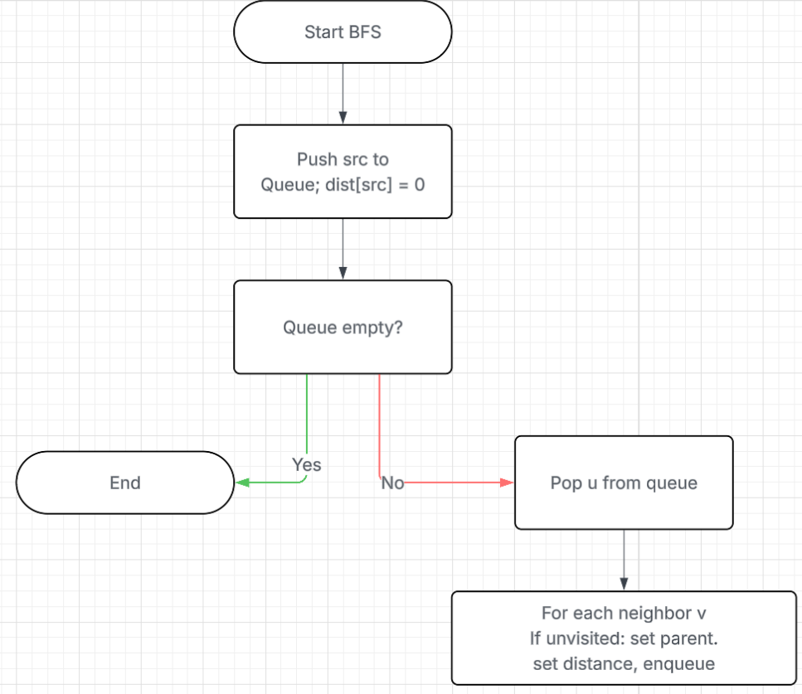
Algorithms and flowchart
BFS shortest routes (this is the core algorithm)
DFS reachability tour
Multi BFS routing through B and C
Q4 best meeting city using sum of BFS distances
Flow charts were made via: lucidchart.com

Slide 6
RunTime, Alternatives, and Optimization
RunTime:
Everything O(V+E)
Alternatives:
Adjacency matrix = Too much memory
Dijkstra/A = not needed (unweighted)
Floyd Warshall = O(V^3), too slow
Optimizations:
Parallel BFS
BFS memoization
Graph compression

Slide 7
Scalability and Conclusion
Adjacency list scales well
Hash map remains Efficient
For millions of cities -> compression/distributed graph
Final conclusions
Key Improvements:
Reduce repeated code with helper functions
Strengthen input validation
Fix small indexing issues
Improve output clarity
Add more organized structure with smaller functions
Improve comments and documentation
Handle edge cases more clearly
More polished formatting
Question 4 is the hardest task
Because it requires multiple BFS runs, full-path reconstruction, global optimization over all nodes, and multi-source reachability comparison.

